Slide 1
Neutral Masks
Movement and Ritual

Slide 2
So far you have...
Looked at Greek Theatre and chorus
Performed a short extract from Medea.
Chosen some images of various performances featuring a Chorus, and analysed the use of space/levels/formation.
Participated in various ‘mirror’ exercises.

Slide 3
Today you will...
Begin to develop your own Masked choral work (2 mins max)
For this you will need to develop various movement sequences. These must include repetitive actions.
Some of these should involve the group moving in unison, as well as individuals moving independently of the group. There should be one central actor.
Consider your use of space, levels and pace. Experiment with contrasts.
Remember to consider the audience perspective, and keep the Masks towards the audience where possible.

Slide 4
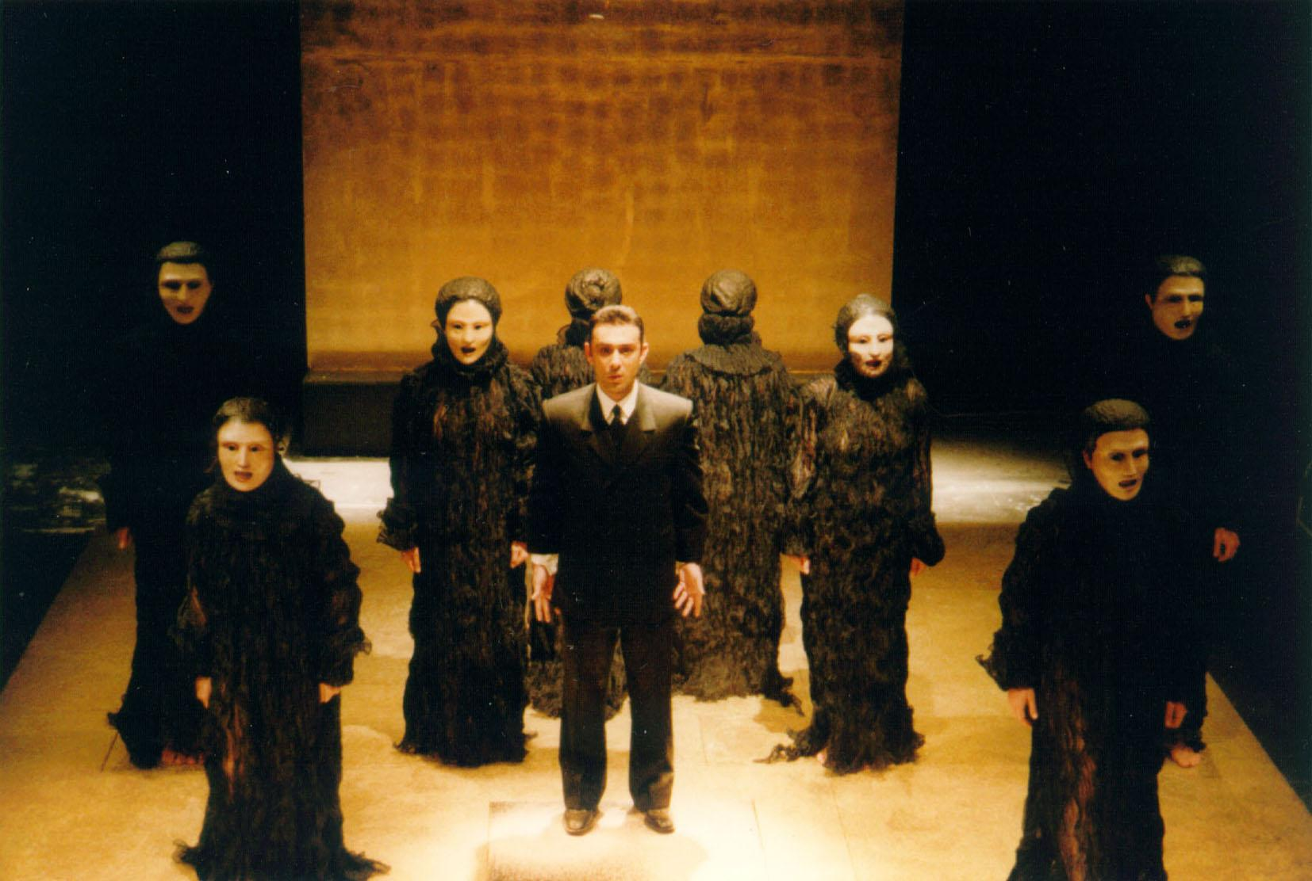
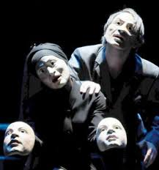
Some images

Slide 5
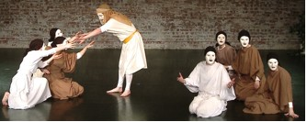
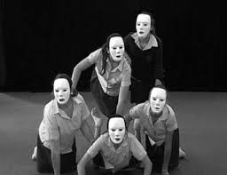
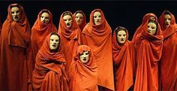
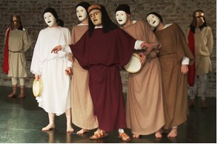
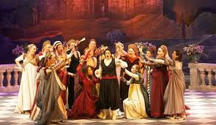
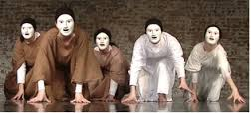
Images

Slide 6
Videos

Slide 7
Videos

Slide 8
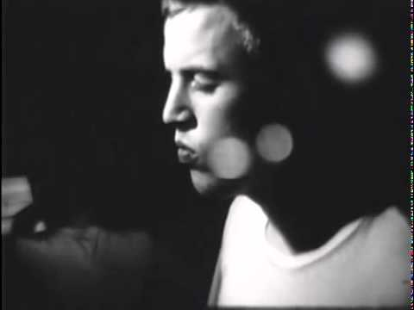
Music

Slide 9
Process work
Once you have the basic structure of your piece I want you to film your work.
Watch this as a group and discuss areas for improvement.
Screen shot TWO images each from the video that show an important movement/an idea you contributed/a moment of creative thinking etc.
Insert these into a document and write about why you chose this image and what it shows/highlights.

Slide 10
Groups

